Slide 1

Incentivizing Sustainable Data Exchanges through Unique Contextualization of History and Destiny
Wout Slabbinck

Slide 2
Wout is a PhD student

Slide 3
Wout is a PhD student Wout is a Postdoctoral Researcher

Slide 4
Wout is a PhD student Wout is a Postdoctoral Researcher Wout is a Professor

Slide 5

Exchanging raw data is hard
Sender
Receiver
How to indicate how data must be used
How to verify the accuracy
How to use the data
How to comply with laws
Implicit Trust

Slide 6


Laws and regulation dictate how to use data
Restrictive
Do not use the data without consent
Don’t store data without security measures
Use the data only for a given purpose
Why not prescriptive?
How do you properly manage consent?
Can we ask the data just in time?
What counts as compatible purpose within the context?
Notes:
<a href="https://www.flaticon.com/free-icons/lock" title="lock icons">Lock icons created by Those Icons - Flaticon</a>
<a href="https://www.flaticon.com/free-icons/blueprint" title="blueprint icons">Blueprint icons created by Freepik - Flaticon</a>
Trade-off consent: well-informed vs concise
Purpose: it is based on the context (research vs research for creating new medecine for project x)

Slide 7
Businesses want to do the right thing
The acting
The willing
The unwilling
Notes:
Any socioeconomic system relies on the assumption that at least 50% of parties will attempt to
do the right thing; otherwise, its society would be effectively lawless. However, the encoding of
ethics and morality into law usually follows a restrictive character, not a prescriptive one.
Legal texts focus on restrictive
• the acting, who are already adhering to the letter and the spirit of the law;
• the willing, who want to adhere, but face obstacles of effort and cost;
• the unwilling, who deliberately attempt what law decisively forbids.
Our focus -> the willing

Slide 8
Trust Envelopes provide unicity of contextualization of history and destiny
Exchanging data via Trust Envelope reduces the cost for data processors to do the right thing

Slide 9
Incentivizing Sustainable Data Exchanges through Unique Contextualization of History and Destiny
Why does our data need trust?
Capturing history and destiny with Trust Envelopes
Where we are and where we want to go?

Slide 10
Incentivizing Sustainable Data Exchanges through Unique Contextualization of History and Destiny
Why does our data need trust?
Capturing history and destiny with Trust Envelopes
Where we are and where we want to go?
Notes:
digital trust: “evidence that an entity has behaved and/or will behave in accordance with the self-stated behaviour”
technology trust: “the subjective belief by which an organization assesses that the underlying technology infrastructure and support mechanisms
are capable of supporting interorganizational communications, transactions, and collaborations”

Slide 11




Accessing age-restricted goods
Notes:
<a href="https://www.flaticon.com/free-icons/shop" title="shop icons">Shop icons created by Freepik - Flaticon</a>
<a href="https://www.flaticon.com/free-icons/liquor" title="liquor icons">Liquor icons created by Freepik - Flaticon</a>
<a href="https://www.flaticon.com/free-icons/office-worker" title="office worker icons">Office worker icons created by nangicon - Flaticon</a>
<a href="https://www.flaticon.com/free-icons/age-restriction" title="age restriction icons">Age restriction icons created by umarbwn - Flaticon</a>

Slide 12
Accessing age-restricted goods
Wants to prove they are allowed to make the purchase
Meet legal obligations
Legal threshold is met
Provable for later audits
Does not want to share sensitive information
Actually does not need age information
Notes:
<a href="https://www.flaticon.com/free-icons/shop" title="shop icons">Shop icons created by Freepik - Flaticon</a>
<a href="https://www.flaticon.com/free-icons/liquor" title="liquor icons">Liquor icons created by Freepik - Flaticon</a>
<a href="https://www.flaticon.com/free-icons/office-worker" title="office worker icons">Office worker icons created by nangicon - Flaticon</a>

Slide 13
Incentivizing Sustainable Data Exchanges through Unique Contextualization of History and Destiny
Why does our data need trust?
Capturing history and destiny with Trust Envelopes
Where we are and where we want to go?

Slide 14
Incentivizing Sustainable Data Exchanges through Unique Contextualization of History and Destiny
Why does our data need trust?
Capturing history and destiny with Trust Envelopes
Where we are and where we want to go?

Slide 15
Capturing history and destiny with Trust Envelopes

Slide 16
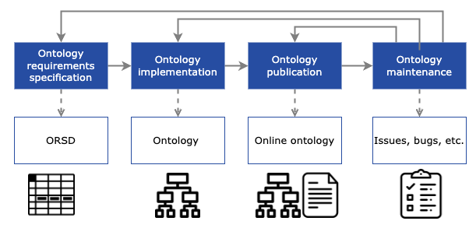
Capturing history and destiny with Trust Envelopes Linked Open Terms Methodology
https://lot.linkeddata.es/

Slide 17
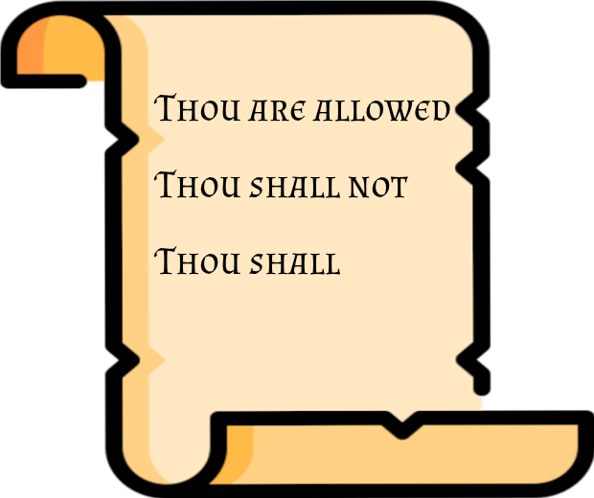
Explicitness from senders
Usage Control
WHO can perform what ACTION on which RESOURCE under which CONDITIONS

Slide 18
Specificity from recipients
Which data and for what purpose
High signal-to-noise
Data tailored for the recipient
Reduces exposure for the sender

Slide 19

Legal Compliance
DGA
DMA
DSA
Data
Act
EUDI
AI
Act
EHDS

Slide 20
Accountability
Data verification
Demonstrate compliance with policies
Demonstrate compliance with legal requirements
Notes:
- Data Unit
- preferably verifiable data
- Data Provenance
- **Sender**: Entity that issues the trust envelope.
- **data subject/data holder**
- to whom the data belongs to
- data subject if personal data
- data holder if non personal data
- Policy
- Usage Policy
- rules about the future use of the data
- Policy provenance
- **Recipient**: Entity that receives the trust envelope.
- **Rights holder**: Entity claiming to have usage rights over the data unit.
- Picture: Intellectual property (photographer) and the persons therein (myself)

Slide 21
Uniqueness of each exchange
Because of all of the above
The data should only make sense for the context between sender and recipient
Non-transferable to other parties
Highly granular single purpose data point
Notes:
The combination, the negotiation between sender and recipient results in highly specific, contextualized data

Slide 22
Requirements
Explicitness from senders
Specificity from recipients
Legal Compliance
Accountability

Slide 23
Capturing history and destiny with Trust Envelopes Linked Open Terms Methodology
https://lot.linkeddata.es/

Slide 24
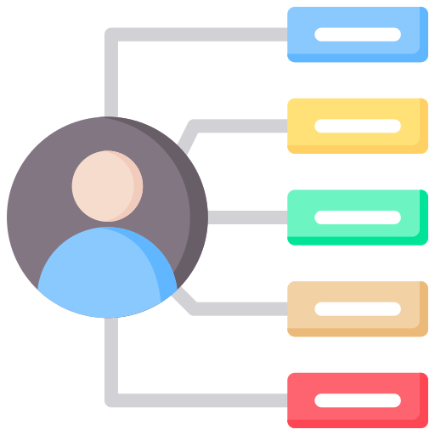
Notes:
<a href="https://www.flaticon.com/free-icons/characteristics" title="characteristics icons">Characteristics icons created by Uniconlabs - Flaticon</a>
<a href="https://www.flaticon.com/free-icons/regulation" title="regulation icons">Regulation icons created by adrianadam - Flaticon</a>
<a href="https://www.flaticon.com/free-icons/negotiate" title="negotiate icons">Negotiate icons created by Parzival’ 1997 - Flaticon</a>
<a href="https://www.flaticon.com/free-icons/web-site" title="web site icons">Web site icons created by Good Ware - Flaticon</a>
https://www.flaticon.com/free-icons/women
<a href="https://www.flaticon.com/free-icons/office-worker" title="office worker icons">Office worker icons created by nangicon - Flaticon</a>
<a href="https://www.flaticon.com/free-icons/calendar" title="calendar icons">Calendar icons created by Freepik - Flaticon</a>

Slide 25

Verifiable data
Notes:
<a href="https://www.flaticon.com/free-icons/characteristics" title="characteristics icons">Characteristics icons created by Uniconlabs - Flaticon</a>
<a href="https://www.flaticon.com/free-icons/regulation" title="regulation icons">Regulation icons created by adrianadam - Flaticon</a>
<a href="https://www.flaticon.com/free-icons/negotiate" title="negotiate icons">Negotiate icons created by Parzival’ 1997 - Flaticon</a>
<a href="https://www.flaticon.com/free-icons/web-site" title="web site icons">Web site icons created by Good Ware - Flaticon</a>
https://www.flaticon.com/free-icons/women
<a href="https://www.flaticon.com/free-icons/office-worker" title="office worker icons">Office worker icons created by nangicon - Flaticon</a>
<a href="https://www.flaticon.com/free-icons/calendar" title="calendar icons">Calendar icons created by Freepik - Flaticon</a>

Slide 26



Verifiable data
Data Provenance
Notes:
<a href="https://www.flaticon.com/free-icons/characteristics" title="characteristics icons">Characteristics icons created by Uniconlabs - Flaticon</a>
<a href="https://www.flaticon.com/free-icons/regulation" title="regulation icons">Regulation icons created by adrianadam - Flaticon</a>
<a href="https://www.flaticon.com/free-icons/negotiate" title="negotiate icons">Negotiate icons created by Parzival’ 1997 - Flaticon</a>
<a href="https://www.flaticon.com/free-icons/web-site" title="web site icons">Web site icons created by Good Ware - Flaticon</a>
https://www.flaticon.com/free-icons/women
<a href="https://www.flaticon.com/free-icons/office-worker" title="office worker icons">Office worker icons created by nangicon - Flaticon</a>
<a href="https://www.flaticon.com/free-icons/calendar" title="calendar icons">Calendar icons created by Freepik - Flaticon</a>

Slide 27

Verifiable data
Policy
Data Provenance
Notes:
<a href="https://www.flaticon.com/free-icons/characteristics" title="characteristics icons">Characteristics icons created by Uniconlabs - Flaticon</a>
<a href="https://www.flaticon.com/free-icons/regulation" title="regulation icons">Regulation icons created by adrianadam - Flaticon</a>
<a href="https://www.flaticon.com/free-icons/negotiate" title="negotiate icons">Negotiate icons created by Parzival’ 1997 - Flaticon</a>
<a href="https://www.flaticon.com/free-icons/web-site" title="web site icons">Web site icons created by Good Ware - Flaticon</a>
https://www.flaticon.com/free-icons/women
<a href="https://www.flaticon.com/free-icons/office-worker" title="office worker icons">Office worker icons created by nangicon - Flaticon</a>
<a href="https://www.flaticon.com/free-icons/calendar" title="calendar icons">Calendar icons created by Freepik - Flaticon</a>

Slide 28
Verifiable data
Policy
Icons from Uniconlabs, adrianadam, Parzival’ 1997, Good Ware, Flaticon, nangicon, and Freepik.
Data Provenance
Policy Provenance
Notes:
<a href="https://www.flaticon.com/free-icons/characteristics" title="characteristics icons">Characteristics icons created by Uniconlabs - Flaticon</a>
<a href="https://www.flaticon.com/free-icons/regulation" title="regulation icons">Regulation icons created by adrianadam - Flaticon</a>
<a href="https://www.flaticon.com/free-icons/negotiate" title="negotiate icons">Negotiate icons created by Parzival’ 1997 - Flaticon</a>
<a href="https://www.flaticon.com/free-icons/web-site" title="web site icons">Web site icons created by Good Ware - Flaticon</a>
https://www.flaticon.com/free-icons/women
<a href="https://www.flaticon.com/free-icons/office-worker" title="office worker icons">Office worker icons created by nangicon - Flaticon</a>
<a href="https://www.flaticon.com/free-icons/calendar" title="calendar icons">Calendar icons created by Freepik - Flaticon</a>

Slide 29

Icons from Uniconlabs, adrianadam, Parzival’ 1997, Good Ware, Flaticon, nangicon, and Freepik.
Notes:
<a href="https://www.flaticon.com/free-icons/characteristics" title="characteristics icons">Characteristics icons created by Uniconlabs - Flaticon</a>
<a href="https://www.flaticon.com/free-icons/regulation" title="regulation icons">Regulation icons created by adrianadam - Flaticon</a>
<a href="https://www.flaticon.com/free-icons/negotiate" title="negotiate icons">Negotiate icons created by Parzival’ 1997 - Flaticon</a>
<a href="https://www.flaticon.com/free-icons/web-site" title="web site icons">Web site icons created by Good Ware - Flaticon</a>
https://www.flaticon.com/free-icons/women
<a href="https://www.flaticon.com/free-icons/office-worker" title="office worker icons">Office worker icons created by nangicon - Flaticon</a>
<a href="https://www.flaticon.com/free-icons/calendar" title="calendar icons">Calendar icons created by Freepik - Flaticon</a>

Slide 30
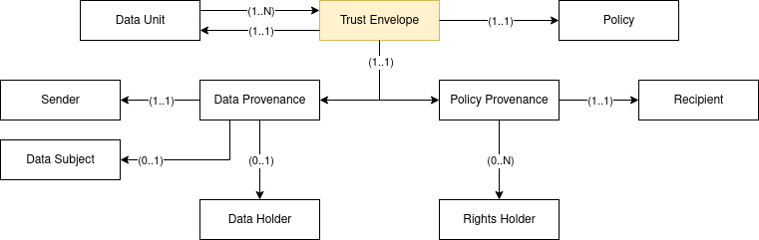
Trust Envelope Ontology
Notes:
- Data Unit
- preferably verifiable data
- Data Provenance
- **Sender**: Entity that issues the trust envelope.
- **data subject/data holder**
- to whom the data belongs to
- data subject if personal data
- data holder if non personal data
- Policy
- Usage Policy
- rules about the future use of the data
- Policy provenance
- **Recipient**: Entity that receives the trust envelope.
- **Rights holder**: Entity claiming to have usage rights over the data unit.
- Example of multiple; a Picture: Intellectual property (photographer) and the persons therein (myself)

Slide 31
Trust Envelope Ontology
Reuses Standards
Policies
Open Digital Rights Language (ODRL)
Digital Privacy Vocabulary (DPV)
Verifiable Data
Verifiable Credentials (VCs)
Provenance
DCMI Metadata Terms (DCT)

Slide 32
Verifiable data
Notes:
<a href="https://www.flaticon.com/free-icons/characteristics" title="characteristics icons">Characteristics icons created by Uniconlabs - Flaticon</a>
<a href="https://www.flaticon.com/free-icons/regulation" title="regulation icons">Regulation icons created by adrianadam - Flaticon</a>
<a href="https://www.flaticon.com/free-icons/negotiate" title="negotiate icons">Negotiate icons created by Parzival’ 1997 - Flaticon</a>
<a href="https://www.flaticon.com/free-icons/web-site" title="web site icons">Web site icons created by Good Ware - Flaticon</a>
https://www.flaticon.com/free-icons/women
<a href="https://www.flaticon.com/free-icons/office-worker" title="office worker icons">Office worker icons created by nangicon - Flaticon</a>
<a href="https://www.flaticon.com/free-icons/calendar" title="calendar icons">Calendar icons created by Freepik - Flaticon</a>

Slide 33
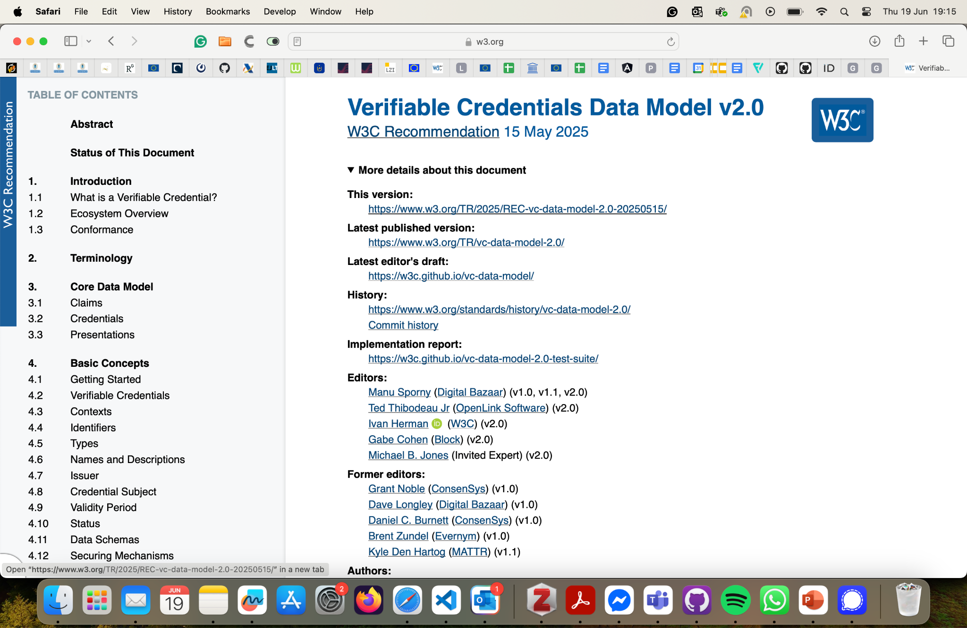
Verifiable data
https://www.w3.org/TR/vc-data-model-2.0/
Notes:
<a href="https://www.flaticon.com/free-icons/characteristics" title="characteristics icons">Characteristics icons created by Uniconlabs - Flaticon</a>
<a href="https://www.flaticon.com/free-icons/regulation" title="regulation icons">Regulation icons created by adrianadam - Flaticon</a>
<a href="https://www.flaticon.com/free-icons/negotiate" title="negotiate icons">Negotiate icons created by Parzival’ 1997 - Flaticon</a>
<a href="https://www.flaticon.com/free-icons/web-site" title="web site icons">Web site icons created by Good Ware - Flaticon</a>
https://www.flaticon.com/free-icons/women
<a href="https://www.flaticon.com/free-icons/office-worker" title="office worker icons">Office worker icons created by nangicon - Flaticon</a>
<a href="https://www.flaticon.com/free-icons/calendar" title="calendar icons">Calendar icons created by Freepik - Flaticon</a>

Slide 34
Verifiable data
Verifiable Credential
Verifiable Presentation
Credential Metadata
Presentation Metadata
Claim(s)
Verifiable Credential(s)
https://www.w3.org/TR/vc-data-model-2.0/
Proof(s)
Proof(s)
Notes:
A credential is a set of one or more claims made by the same entity. Credentials might also include an identifier and metadata to describe properties of the credential, such as the issuer, the validity date and time period, a representative image, verification material, status information, and so on. A verifiable credential is a set of tamper-evident claims and metadata that cryptographically prove who issued it. Examples of verifiable credentials include, but are not limited to, digital employee identification cards, digital driver's licenses, and digital educational certificates.
A verifiable presentation is created by a holder, can express data from multiple verifiable credentials, and can contain arbitrary additional data. They are used to present claims to a verifier. It is also possible to present verifiable credentials directly.
The data in a presentation is often about the same subject but might have been issued by multiple issuers. The aggregation of this information expresses an aspect of a person, organization, or entity.

Slide 35
Instantiated policy
Notes:
<a href="https://www.flaticon.com/free-icons/characteristics" title="characteristics icons">Characteristics icons created by Uniconlabs - Flaticon</a>
<a href="https://www.flaticon.com/free-icons/regulation" title="regulation icons">Regulation icons created by adrianadam - Flaticon</a>
<a href="https://www.flaticon.com/free-icons/negotiate" title="negotiate icons">Negotiate icons created by Parzival’ 1997 - Flaticon</a>
<a href="https://www.flaticon.com/free-icons/web-site" title="web site icons">Web site icons created by Good Ware - Flaticon</a>
https://www.flaticon.com/free-icons/women
<a href="https://www.flaticon.com/free-icons/office-worker" title="office worker icons">Office worker icons created by nangicon - Flaticon</a>
<a href="https://www.flaticon.com/free-icons/calendar" title="calendar icons">Calendar icons created by Freepik - Flaticon</a>

Slide 36
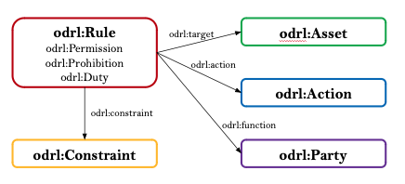
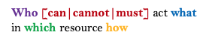
Instantiated policy
Notes:
<a href="https://www.flaticon.com/free-icons/characteristics" title="characteristics icons">Characteristics icons created by Uniconlabs - Flaticon</a>
<a href="https://www.flaticon.com/free-icons/regulation" title="regulation icons">Regulation icons created by adrianadam - Flaticon</a>
<a href="https://www.flaticon.com/free-icons/negotiate" title="negotiate icons">Negotiate icons created by Parzival’ 1997 - Flaticon</a>
<a href="https://www.flaticon.com/free-icons/web-site" title="web site icons">Web site icons created by Good Ware - Flaticon</a>
https://www.flaticon.com/free-icons/women
<a href="https://www.flaticon.com/free-icons/office-worker" title="office worker icons">Office worker icons created by nangicon - Flaticon</a>
<a href="https://www.flaticon.com/free-icons/calendar" title="calendar icons">Calendar icons created by Freepik - Flaticon</a>

Slide 37
W3C Recommendation
Maintained by the W3C ODRL Community Group
Composed by several specifications
ODRL Information Model – W3C Recommendation
ODRL Core Vocabulary – W3C Recommendation
ODRL Implementation Best Practices
ODRL Profile Best Practices
ODRL Formal Semantics [Under development]
Easily extendable through the use of ODRL profiles
Instantiated policy
Notes:
<a href="https://www.flaticon.com/free-icons/characteristics" title="characteristics icons">Characteristics icons created by Uniconlabs - Flaticon</a>
<a href="https://www.flaticon.com/free-icons/regulation" title="regulation icons">Regulation icons created by adrianadam - Flaticon</a>
<a href="https://www.flaticon.com/free-icons/negotiate" title="negotiate icons">Negotiate icons created by Parzival’ 1997 - Flaticon</a>
<a href="https://www.flaticon.com/free-icons/web-site" title="web site icons">Web site icons created by Good Ware - Flaticon</a>
https://www.flaticon.com/free-icons/women
<a href="https://www.flaticon.com/free-icons/office-worker" title="office worker icons">Office worker icons created by nangicon - Flaticon</a>
<a href="https://www.flaticon.com/free-icons/calendar" title="calendar icons">Calendar icons created by Freepik - Flaticon</a>

Slide 38
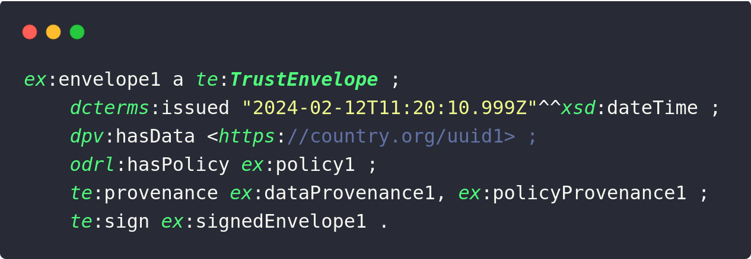
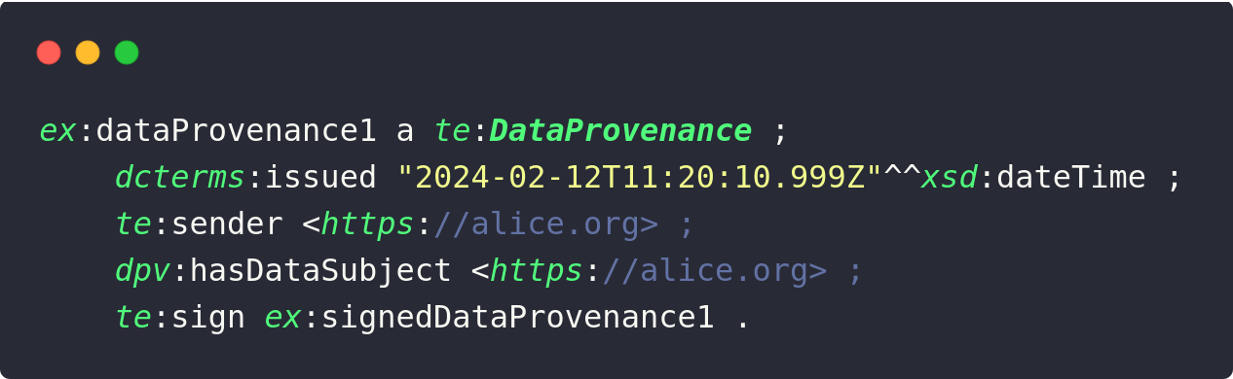
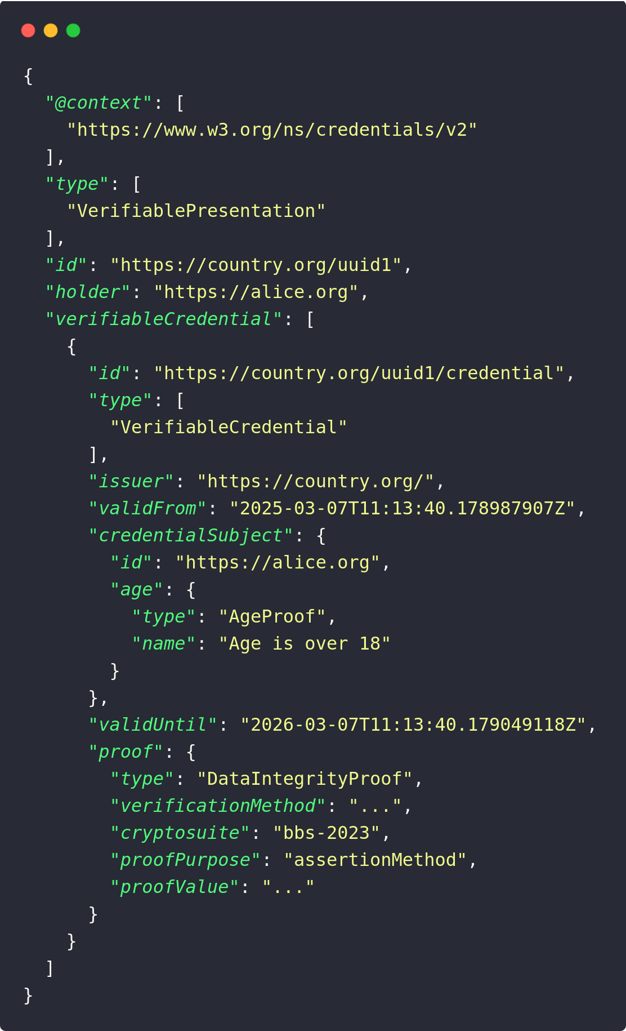
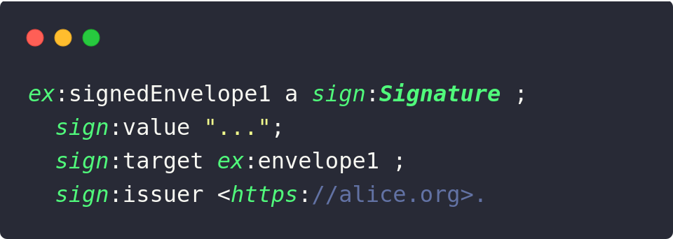
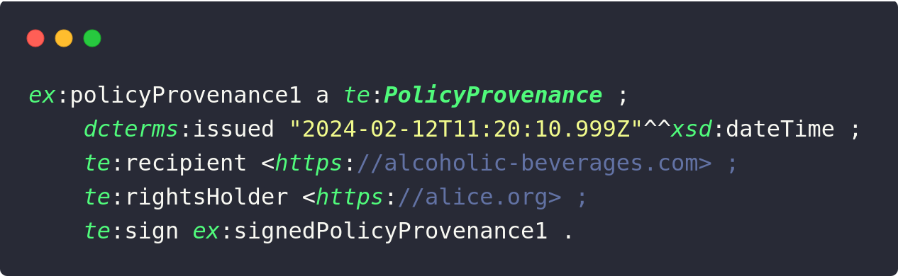
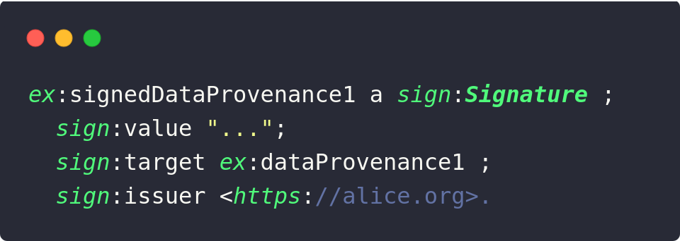
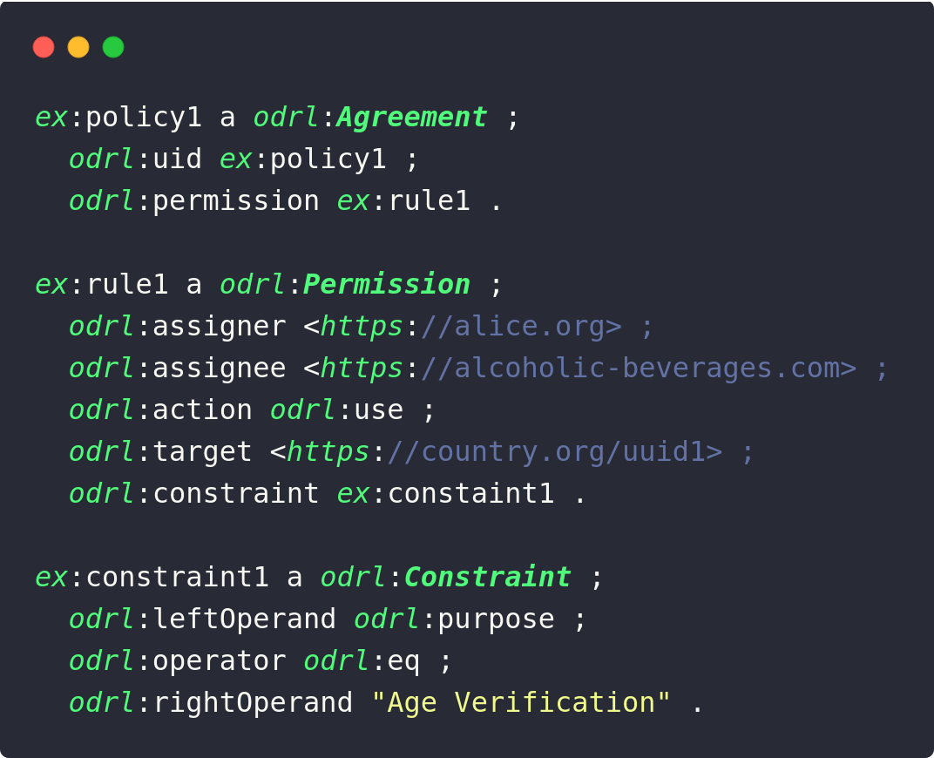
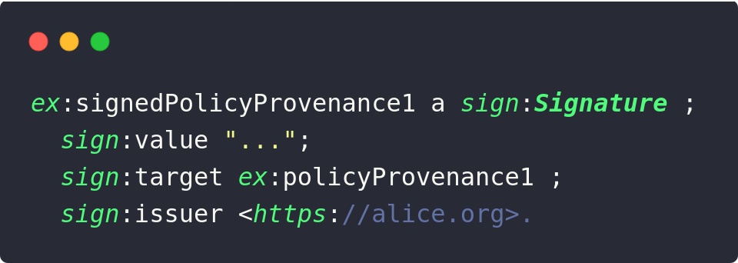
Trust Envelope example

Slide 39
Capturing history and destiny with Trust Envelopes Linked Open Terms Methodology
https://lot.linkeddata.es/

Slide 40
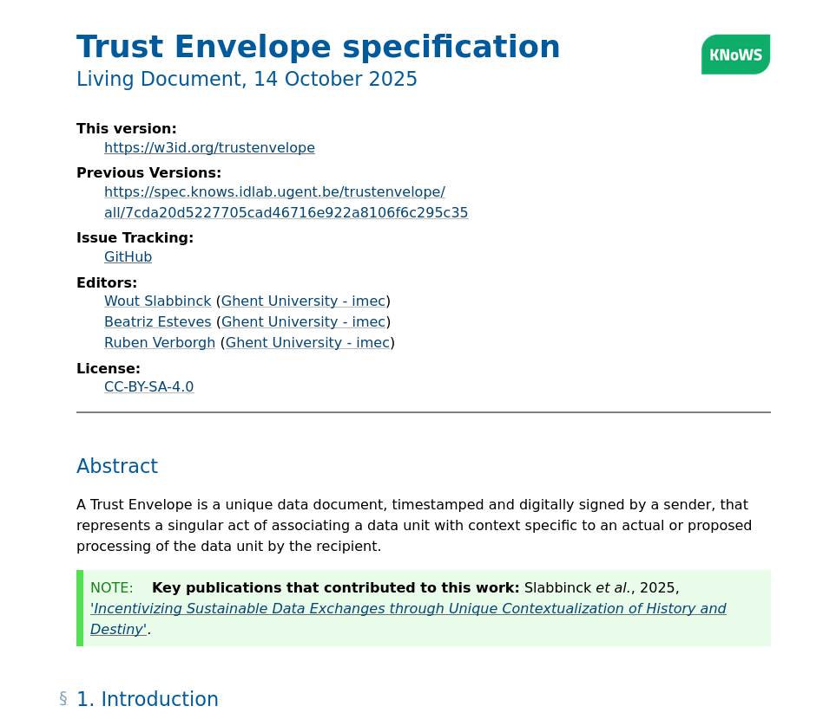
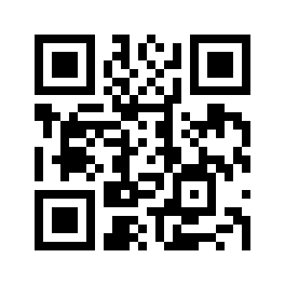

Slide 41
Capturing history and destiny with Trust Envelopes Linked Open Terms Methodology
https://lot.linkeddata.es/

Slide 42
Incentivizing Sustainable Data Exchanges through Unique Contextualization of History and Destiny
Why does our data need trust?
Capturing history and destiny with Trust Envelopes
Where we are and where we want to go?

Slide 43
Incentivizing Sustainable Data Exchanges through Unique Contextualization of History and Destiny
Why does our data need trust?
Capturing history and destiny with Trust Envelopes
Where we are and where we want to go?

Slide 44
Where we are and where we want to go?
Requirements
Explicitness from senders
Specificity from recipients
Legal Compliance
Accountability
Interoperable, Enforceable UCP
Semantics (reuse of ontologies)
Regulation-agnostic design
Trust Envelope signing
Notes:
recipient specificity through allowing precise expression of what the data represents.

Slide 45
Where we are and where we want to go?
Discussion
Signing RDF ambiguity
Verifying with legal experts regarding Trust Envelope validity
Notes:
We believe it will make good behaviour easier while handling data

Slide 46
Where we are and where we want to go?
Future work
Applying the model on real-world scenarios
Incorporate with our authorization framework
UMA Server
ODRL policy engine

Slide 47
Trust Envelopes provide unicity of contextualization of history and destiny
Exchanging data via Trust Envelope reduces the cost for data processors to do the right thing

Slide 48
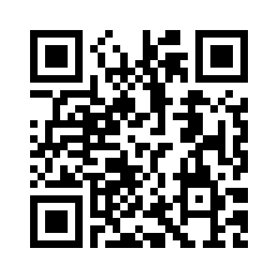

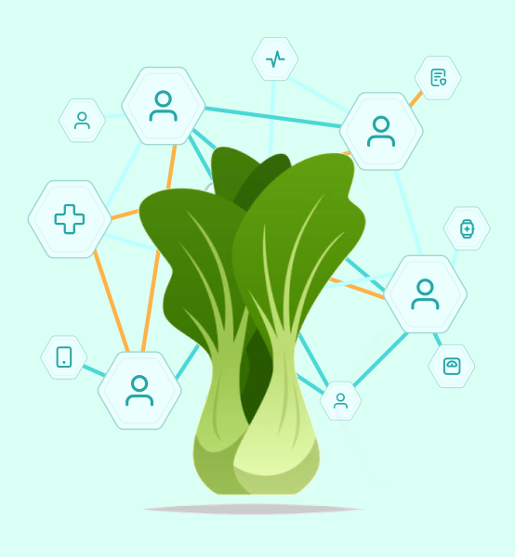

DEPARTMENT ELIS
RESEARCH GROUP IDLab Technology
Incentivizing Sustainable Data Exchanges through Unique Contextualization of History and Destiny
Wout Slabbinck, Beatriz Esteves, Maarten de Mildt, Ruben Dedecker, Julián Rojas Meléndez, Sofie Verbrugge, Didier Colle, Pieter Colpaert, Ruben Verborgh

Slide 49

Why not use decentralized technologies, like Solid
Idea: get control over you data
How? Separation of concerns (decoupling application from storage)
Specification contains the following
Identity and authentication: WebID and Solid-OIDC
Access control policies: WAC and ACL
CRUD Interface: Linked Data Platform (LDP)
Good: keep the source of the data closer to the source of change
Improves changing address when moving houses

Slide 50
Why not use decentralized technologies, like Solid
Identity and authentication
not generic; only valid claim WebID
Access control policies
only access, no deontic concepts (prohibitions, duty), limited constraints
CRUD Interface: Linked Data Platform (LDP)
No data integrity (who was written what)
No data minimisation

